Slide 1
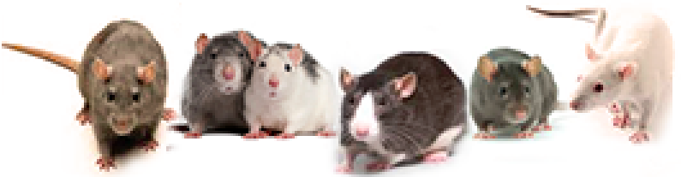
Statistical and genetic functions,
and initial mapping results for
Rat GWAS P50
as implemented in
GeneNetwork.org
(21Apr2020v6)
Williams RW, Centeno A, Chen H, Chitre A, Palmer AA, Prins J, Saba LM, Sen S, Sloan Z, Yousefi S, and P30 + P50 NIDA teams
RatGenes.org
Contact: rwilliams@uthsc.edu

Slide 2
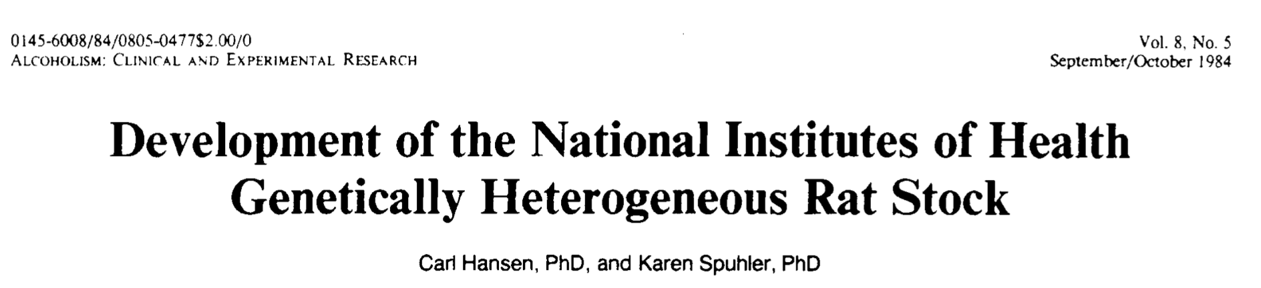
Introduction
Purposes of presentation
For the past five years, the GeneNetwork and NIDA P30 teams have collaborated with AA Palmer and the National Institute on Drug Abuse to simplify genetic analyses of rat heterogeneous stock (HS) cohorts. In close cooperation, RW Williams, L Saba, S Sen have received a wide diversity of data types for HS rats. All of these cases were genotyped by sequencing. In 2019 and 2020, Rat HS phenotype and genotype data were entered in GeneNetwork, an open-source FAIR-compliant genetics web server (P30 DA 044223 to L Saba, S Sen, RWW).
For mapping traits in the rat GWAS, GeneNetwork (GN) now incorporates the GEMMA linear mixed model mapping code written by Xiang Zhou. GEMMA has been substantially improved by P. Prins and colleagues to map traits in the rat HS, including the addition of leave-one-chromosome-out (LOCO).
GN is not perfect yet and are still working hard to improve functions and speed for the P50 team. But definitely usable if you are a bit patient.
1
To provide you with a review or preview of the P50 Rat GWAS molecular, morphometric, and behavioral data using www.genenetwork.org (slides 2,3, 11 to 31)
To provide a primer on using GeneNetwork in combination with Rat GWAS data (slides 4–14)
To provide an overview of some of the mapping results you may have already gotten from Apurva, but now in a web system that allows all of your data and analysis to be Findable, Accessible, Interoperable, and Reusable (FAIR data).
2
3
Most figures, graphs, and tables in this presentation were made directly in GeneNetwork.
Origins of the HS rat population
PMID: 6391259
Slide 2. Introduction

Slide 3


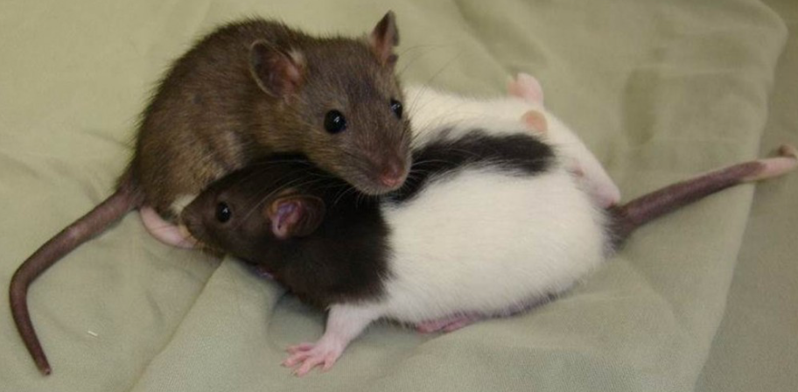
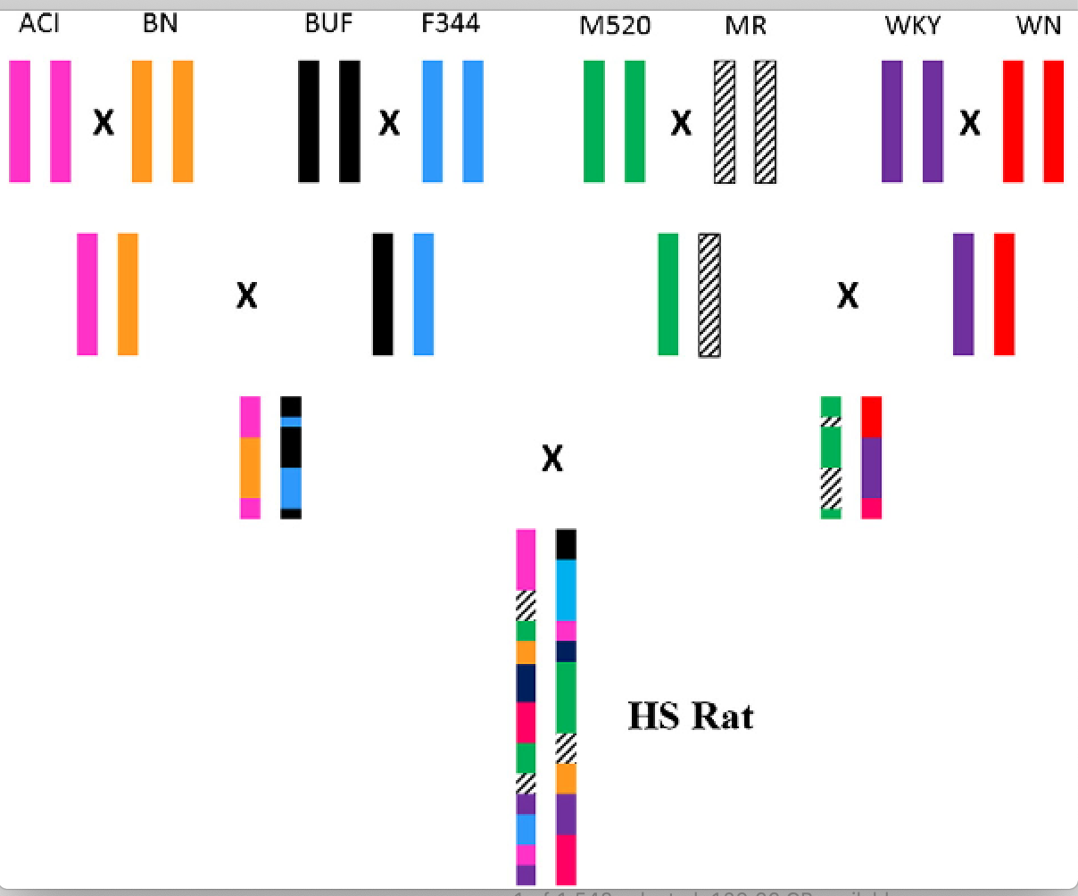
An 8-parent rat HS-AI cross
Genotype sets and mapping models
M1P2
M3P4
M5P6
M7P8
°
First phase mapping done used up to 4000 HS cases and has excellent power. You can map with any cofactors you want—batch, sex, body weight, coat color. Sexes can be mapped jointly and separately.
Second phase omics data mapping is in progress by Saba and Sen, but requires faster methods. We will get there! Also adding in all rat sequence data.
Genome-wide thresholds of linkage can be com–puted in R/qtl with a permutation method that accounts for the stratification of samples by sex, site, and batch. GEMMA works well too but no permutation yet.
Mapping methods make two key assumptions: that distributions of traits are reasonably close to normal and that cofactors are well modeled. Cofactors are treated as fixed effects. HS sample sizes are large enough so that the distinction between fixed and random effect models is not critical.
A/A
B/B
C/C
D/D
E/E
F/F
G/G
H/H
F1
F1
1982
F1
F1
°
F2
N =70F +70M
F2
BN-MR- BUF-M520
WN-ACl-WKY-F344
°
Reciprocal G3
A=BN/SsN
B=MR/N
C=BUF/N
D-M520/N
60 pairs
12 units x 5 cages
effective population
of 120
E=WN/N
F=ACI/N
G=WKY/N
H=F344/N
°
Generation 87
Slide 3. HS rat have A-type or E-type mitochondria and D- or Y chromosomes. Other chromosomes will have a complex mix of the eight parental haplotypes.

Slide 4
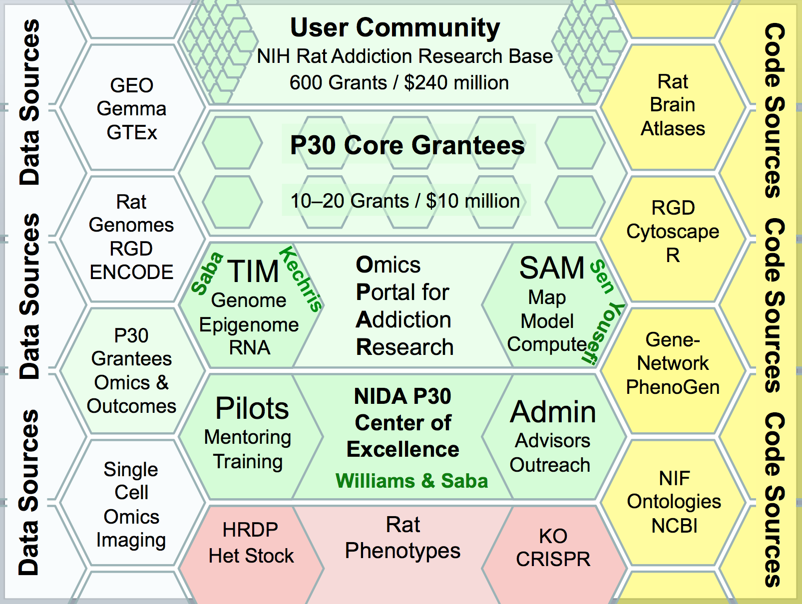
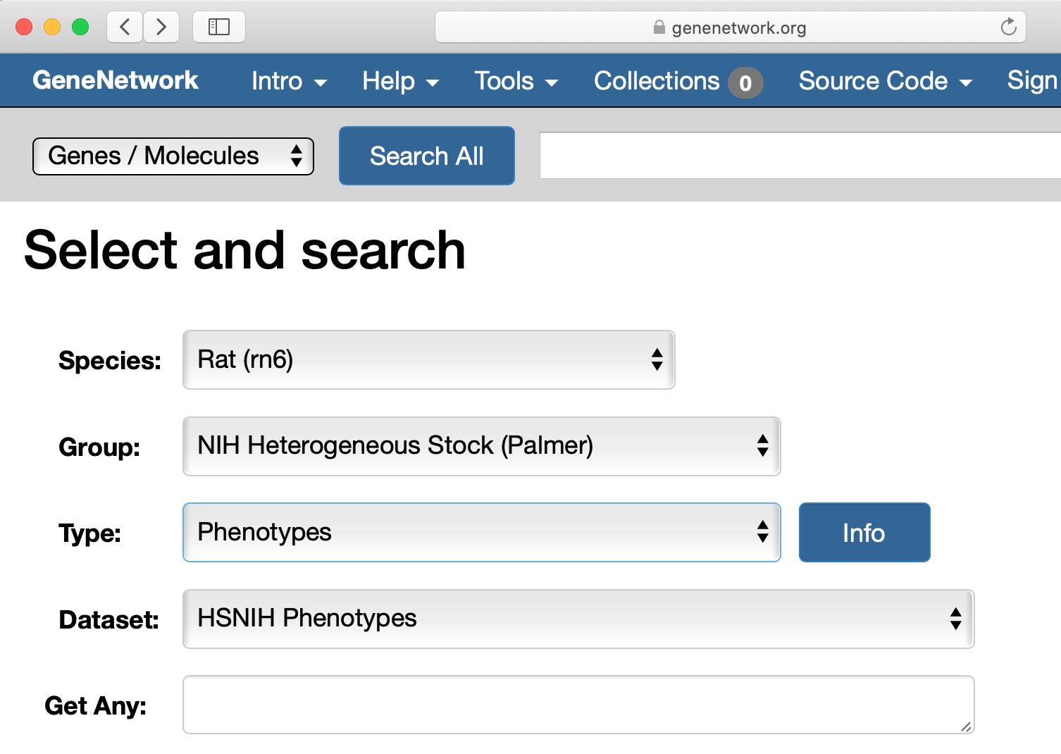
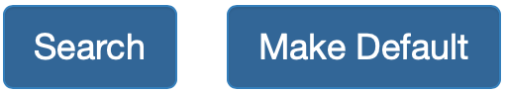
Getting to HS P50 data in GeneNetwork
Link to www.GeneNetwork.org
HS Rat
You are here
*
*
Slide 4. Configure the Select and search page as shown. Click on Make Default. Enter a wildcard ( ) in the Get Any field (red arrow). Click on Search. Just that easy.

Slide 5
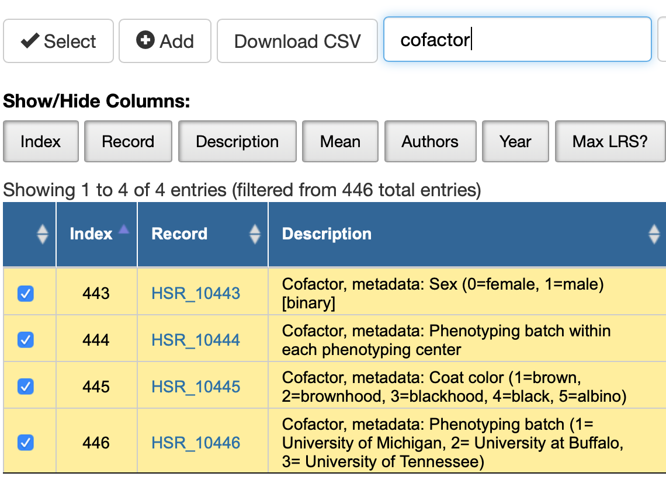
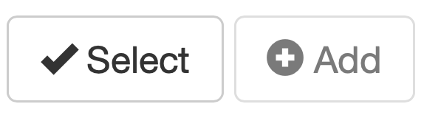
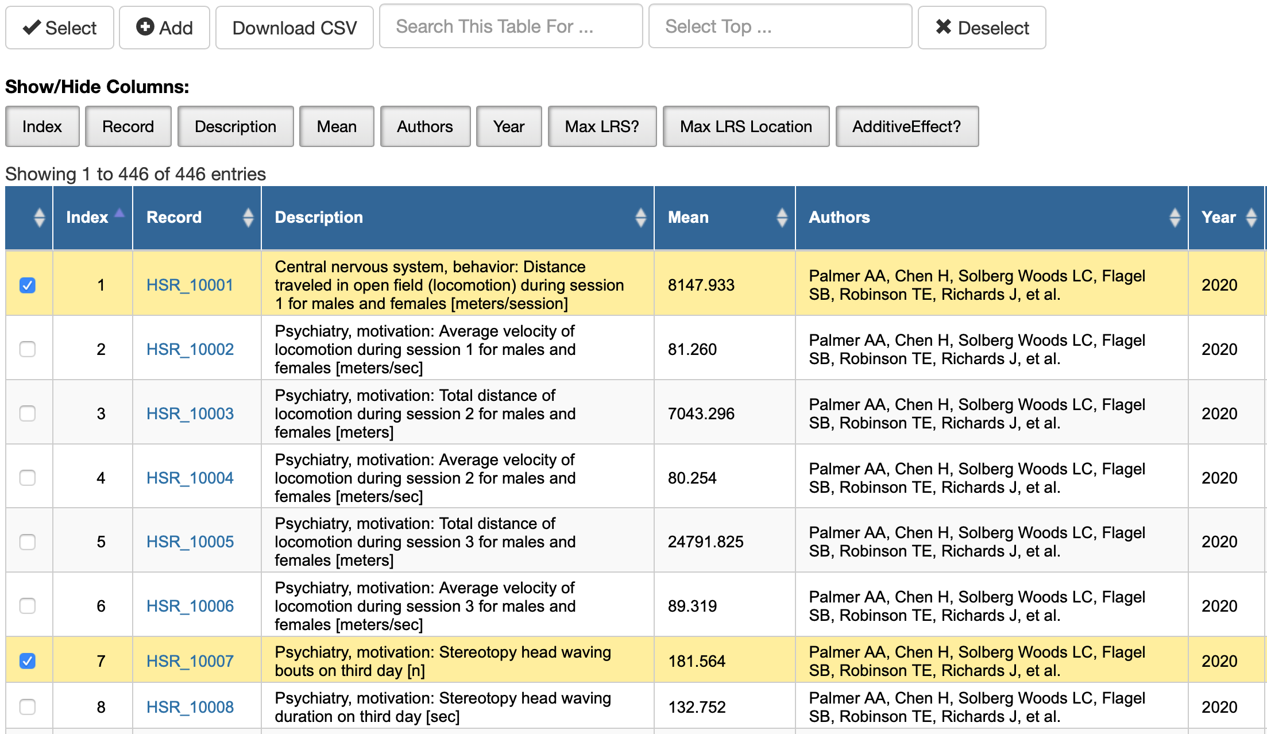
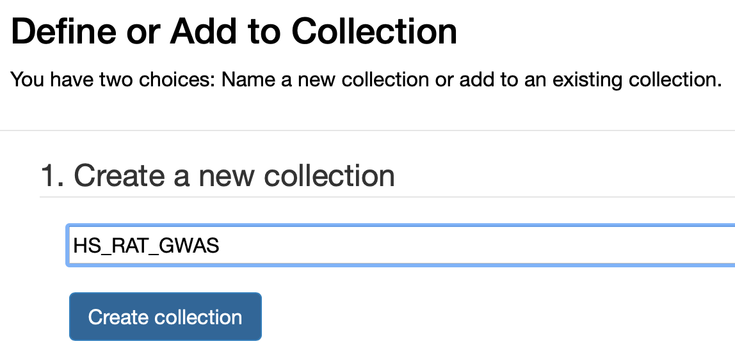
Getting HS data into Your Collection
Slide 5. Search Results. Left. GeneNetwork returns all 446 HS traits and cofactors. These traits are not yet linked to PMID citations. The Palmer AA et al. citation is a placeholder. The Select and Add functions (red arrow) are used in sequence to add traits and cofactors to Your Collection. Top right. Type the search term cofactor into the text field (arrow). Click on Select and Add all of the cofactors to define a Collection—bottom right—here named HS_RAT_GWAS. Collections are needed in order to use cofactors when mapping (sex, batch, site, year…).

Slide 6
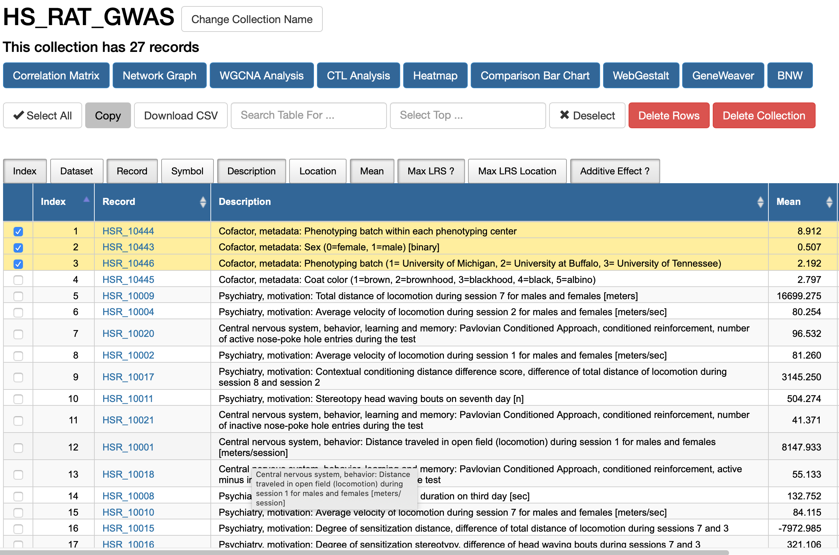
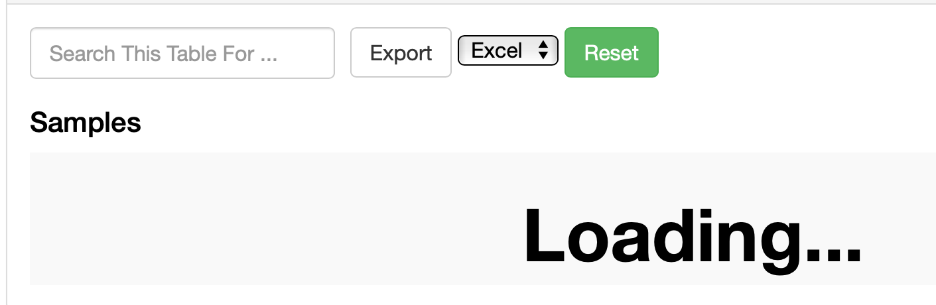
Collection of traits and cofactors
Your now have 2 collections
This link will take you directly to the HS body weight data in GeneNetwork:
http://genenetwork.org/show_trait?trait_id=10441&dataset=HSNIH-PalmerPublish
Known issue: Because the HS rat GWAS data is so deep, opening some windows may take a web browser a few minutes. Don’t be surprised by this window:
2007
Slide 6. Left. The yellow highlighted longevity rows are cofactors. Each trait has a permanent Record identifier with format HSR_NNNNN. They can be cited in papers. To view data click on blue ID numbers (red arrow). Top. Collections, Tools, and Code are available from the menu. Right. Any HS data can be accessed directly with the URL. Please be patient when waiting for the data to load into your browser. It is slow. This is an issue we will resolve (the rat GWAS is one of the largest cohort in GeneNetwork).

Slide 7
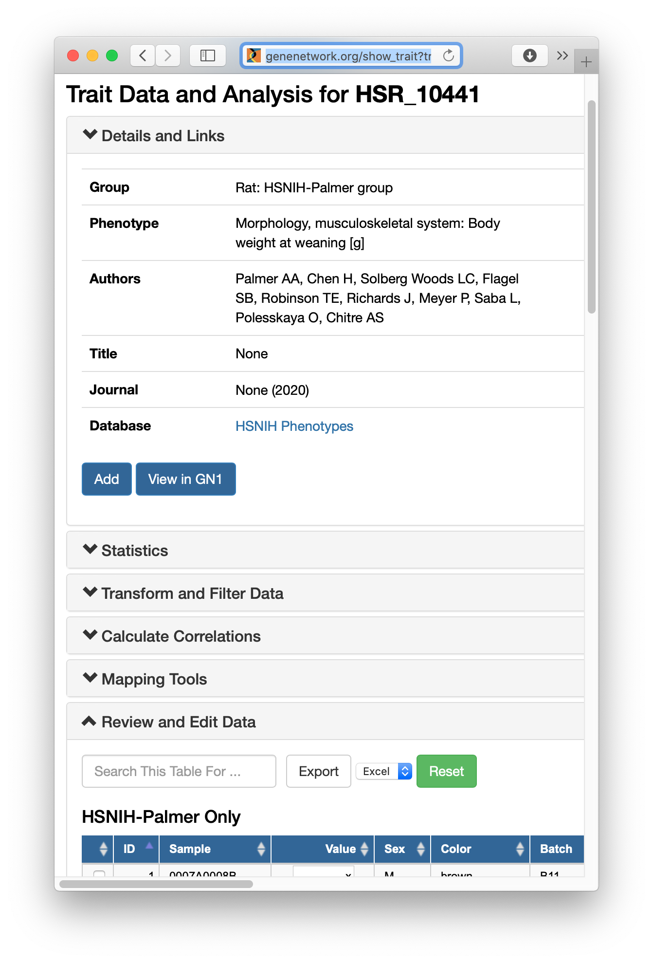
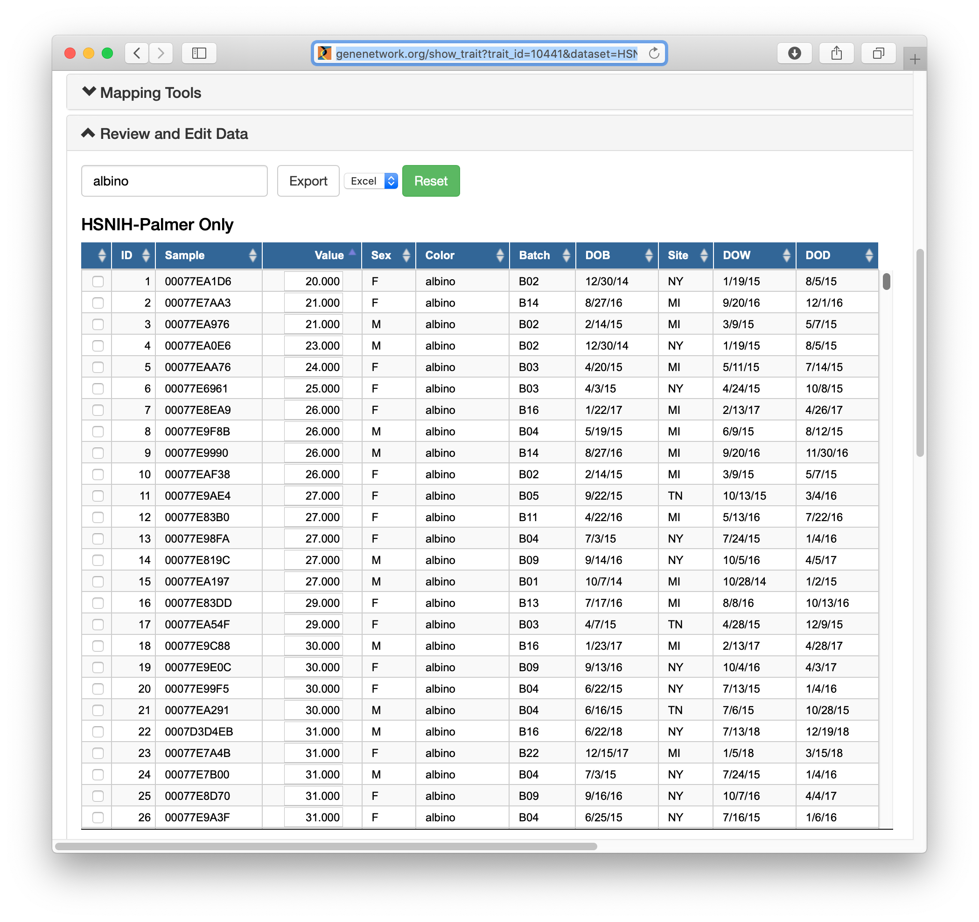
Page top
Page bottom
Slide 7. The HS body weight at weaning data has the accession identifier HSR_10441. Top. The top of the Trait Data and Analysis window for HSR_10441. Bottom. Scroll down to review the actual data and cofactors. Most columns are self-explanatory. DOB, DOW, and DOD are dates of birth, experimental work, and death. In this screenshot, only the albino cases are shown (red arrow).
Known issue: The ITP data sets are large (13284 rows), and loading traits into browser windows may take up to 5 minutes. Sorting all rows is equally slow. We are working toward faster display methods.

Slide 8
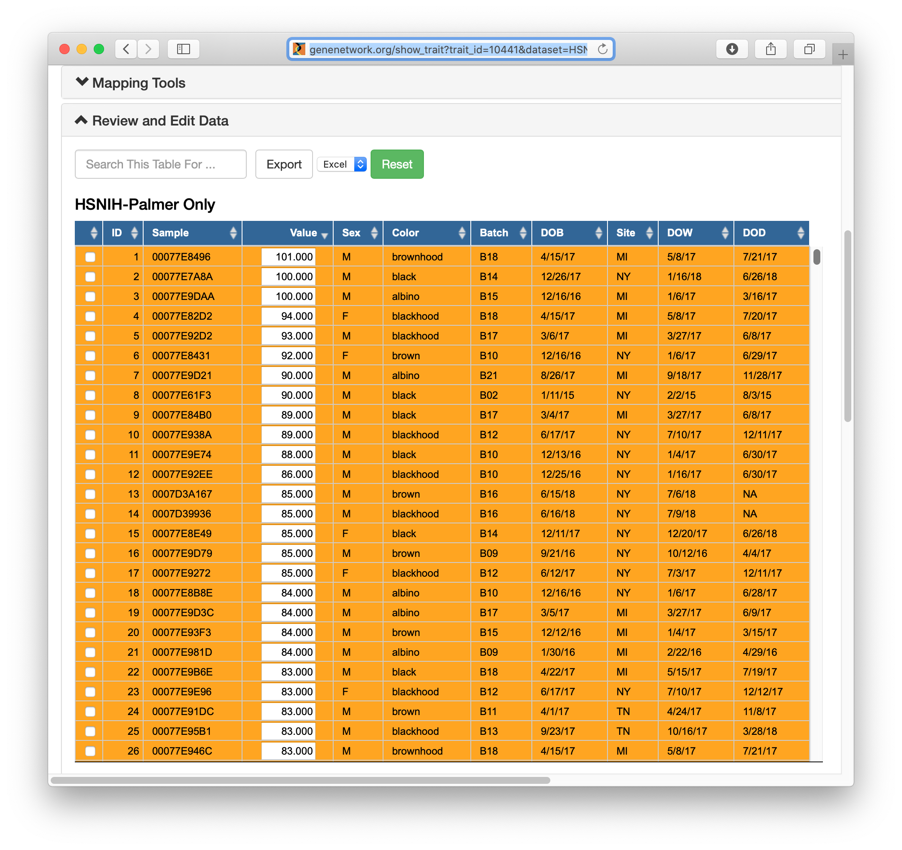
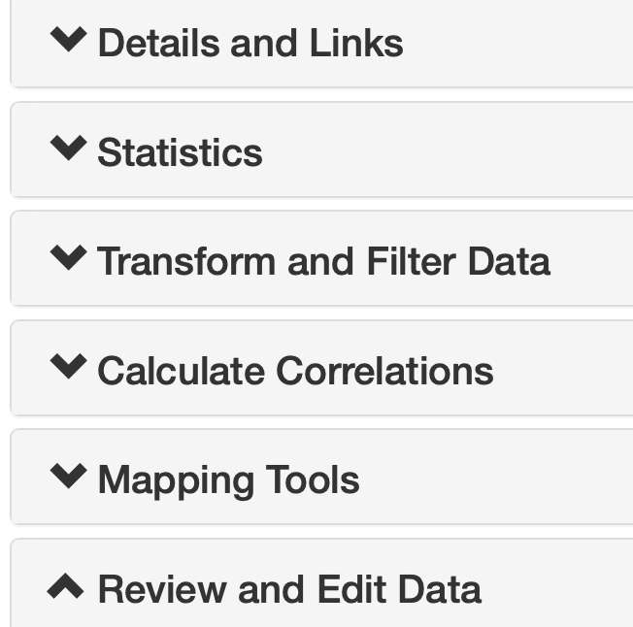
Resorting data from high to low weight
Known issue: The HS Rat GWAS data sets are large (5000+ rows), and loading traits into the browser may take up a few min. Sorting rows is equally slow.
Careful with your clicks: GN will log second and third clicks and spend minutes resorting and then resorting again.
Slide 8. Left. The Trait Data and Analysis window has six major sections. The last is Review and Edit Data (large red arrow) and is open by default. Middle. The Value column (small red arrow) has been sorted from high to low. Sorting will take a minute. Once sorted, rows of outlier cases—those with very high or low values—will be flagged as potential outliers in orange. The Value fields can be edited. You can winsorize outliers.

Slide 9
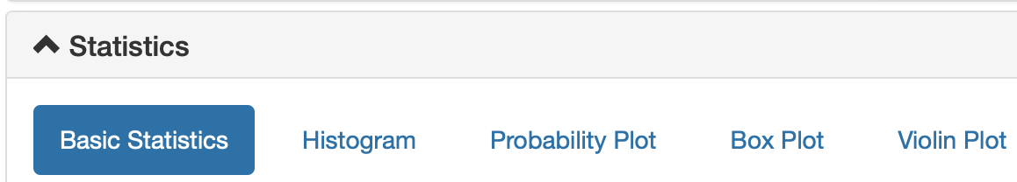

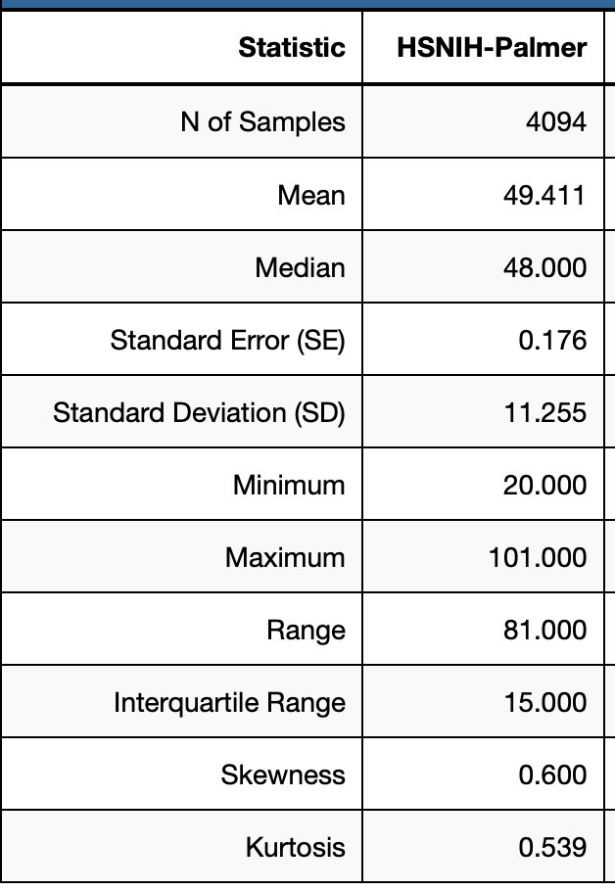
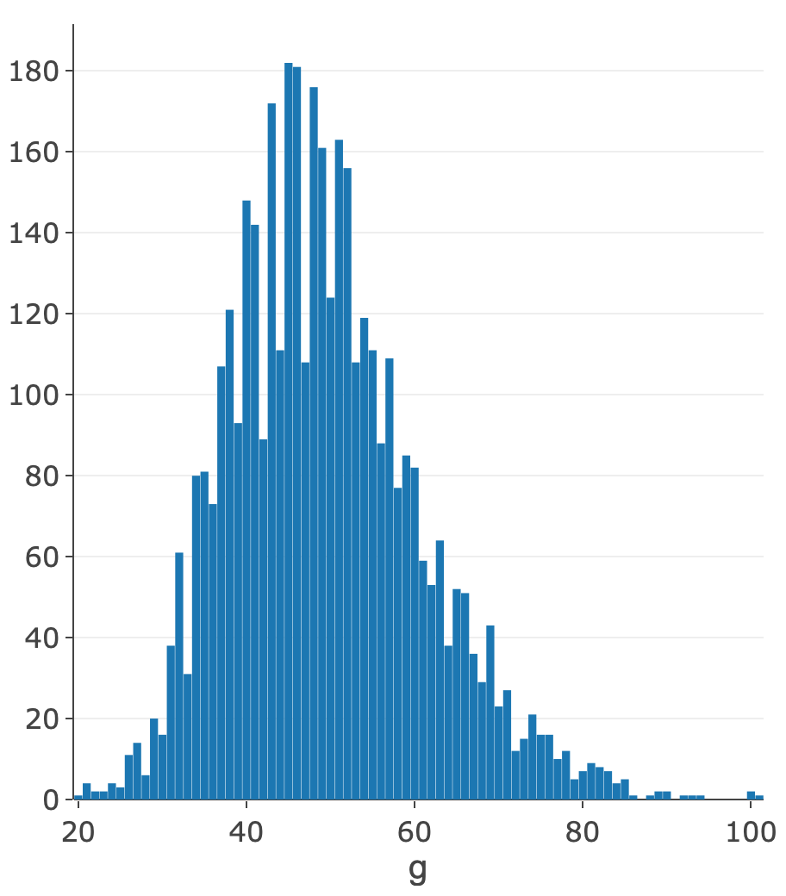
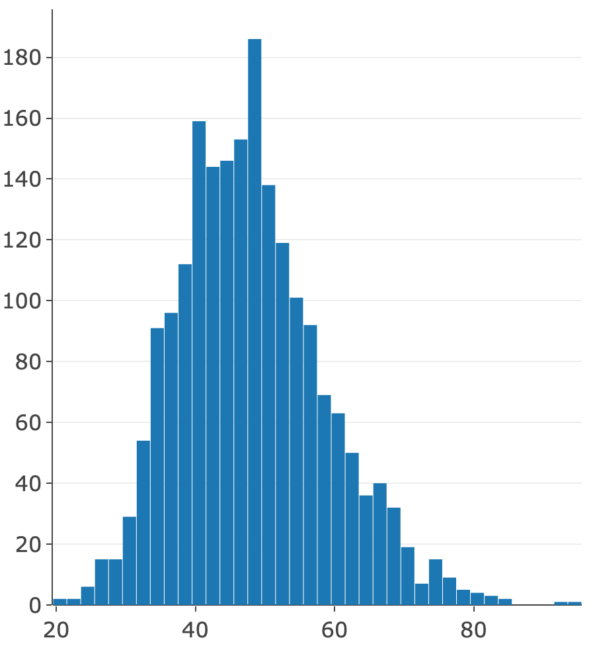
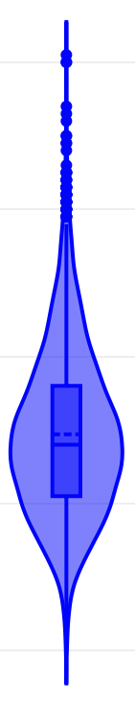

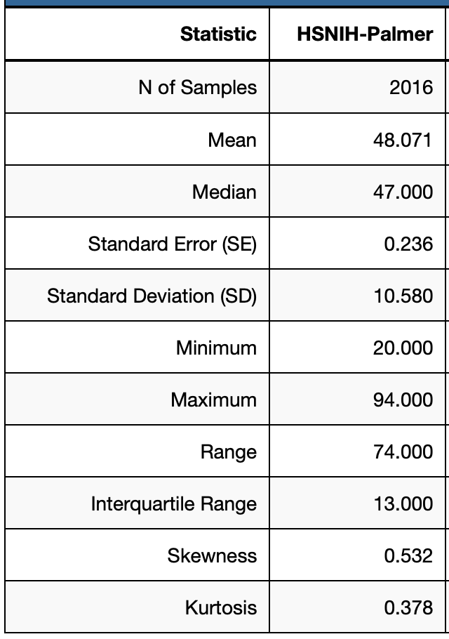
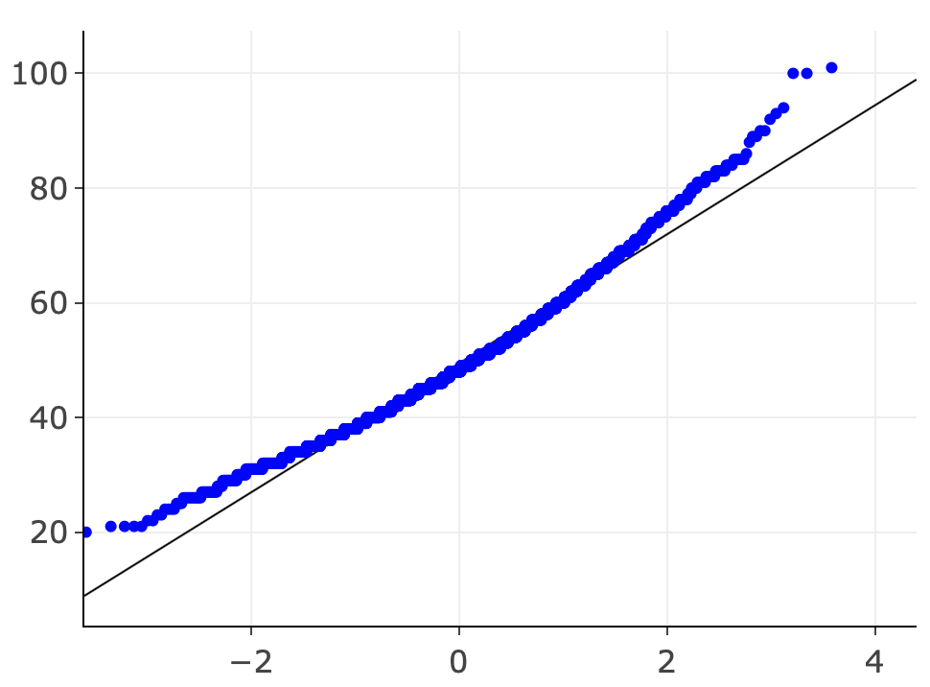
Statistics windows
All
n = 4094
Females
n = 2016
Slide 9. Statistics. Left. Summary table. Middle. Histogram of weanling weight generated using the Statistics Histogram tab. Insets. Quantile probability plots in the two histograms, a violin plot, and statistics. Top. Graphing tools are highlighted in the red box: Edit, Pan, Zoom In, Zoom Out, Autoscale, Reset, Export SVG, and Export JPEG. Left. Histogram of 2016 females. To analyze only females, Block samples by group: Sex = M

Slide 10
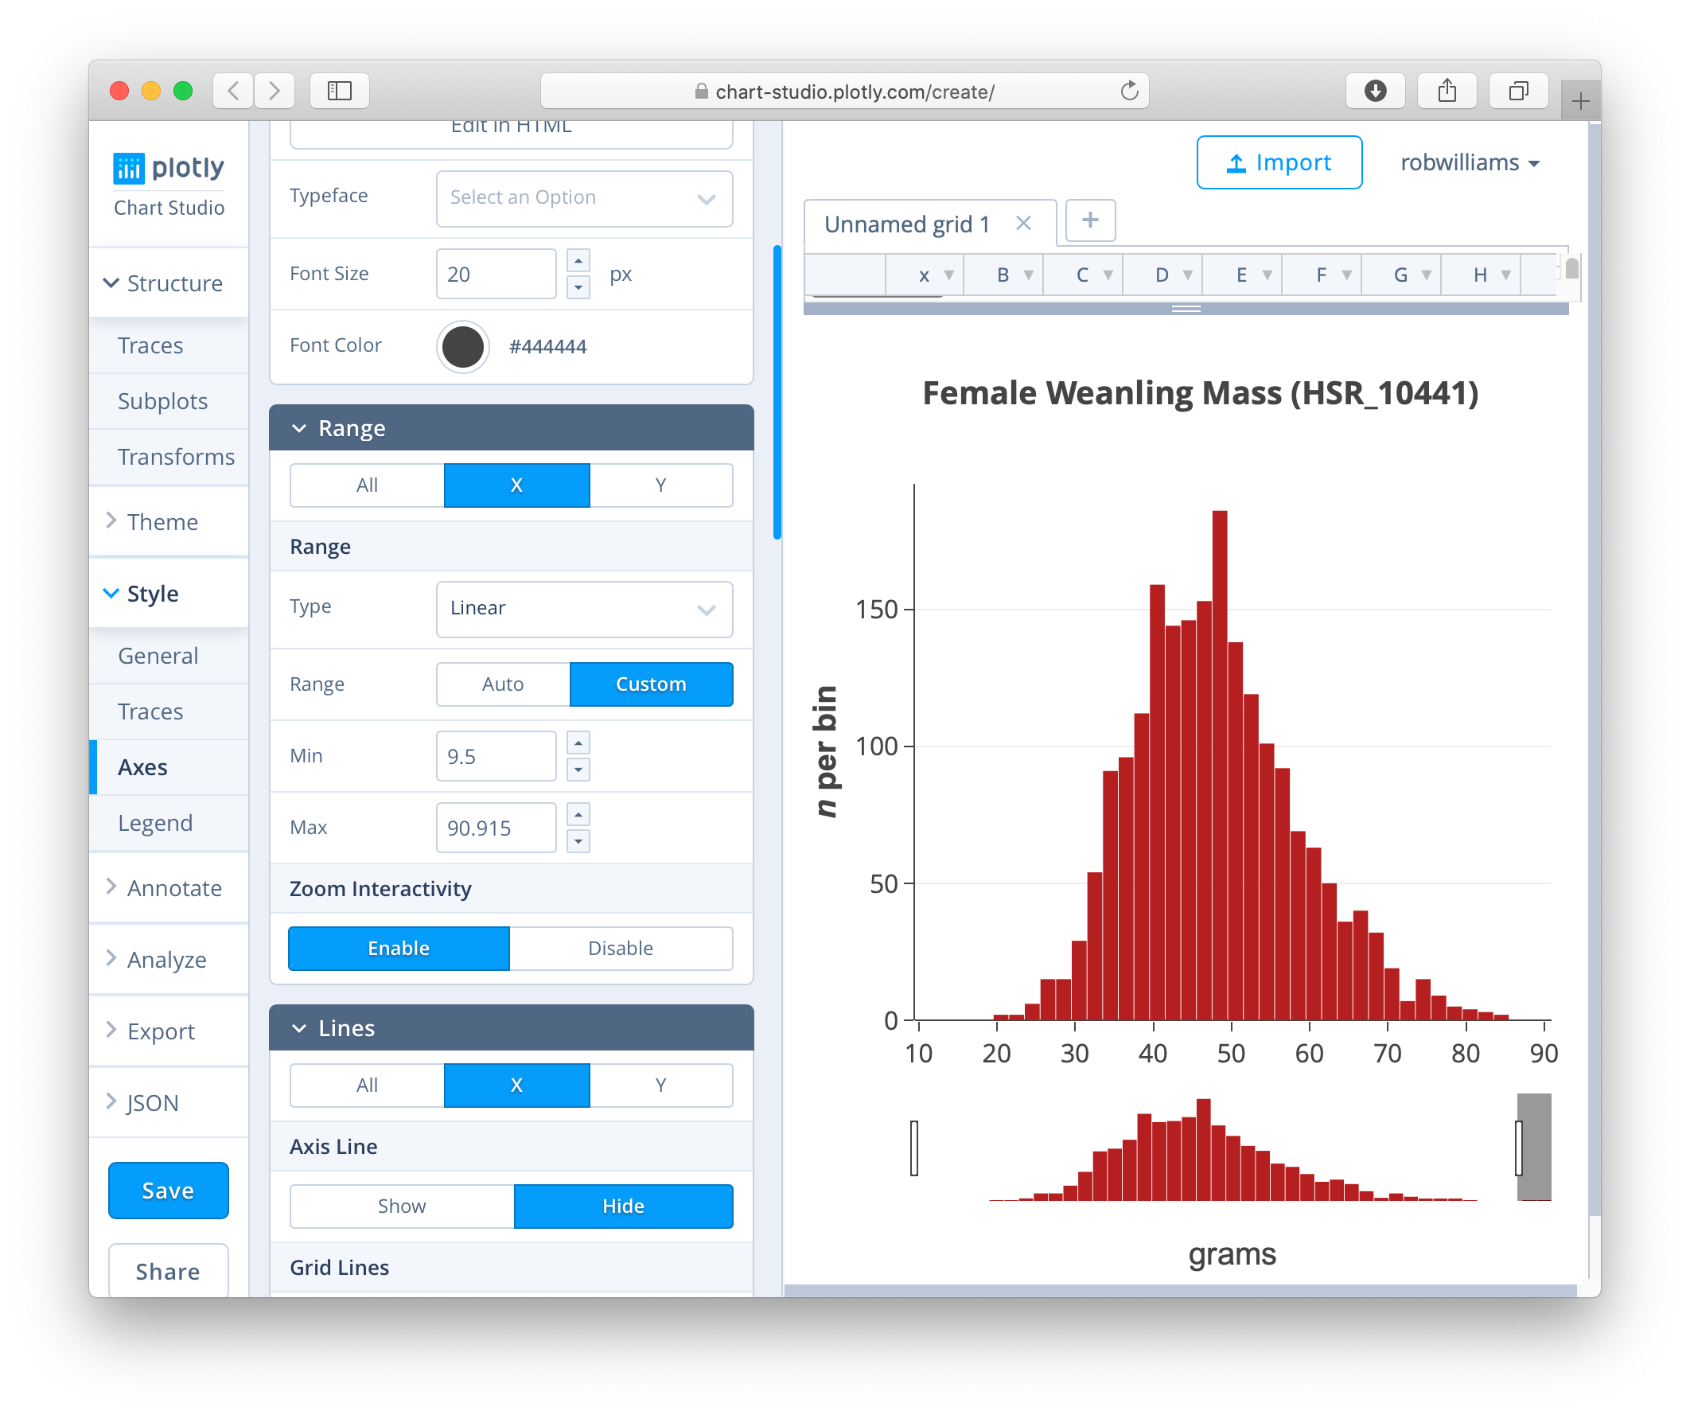
Edit in ChartStudio to get publication quality
Slide 10. Any of the statistic plots generated by Plotly can be modified in Chart Studio. Click on the Edit pencil icon. In this example, a default histogram has been modified in many small ways, including bar color, axes labels, tick marks, and the x-axis has been modified to show bins between 10 and 90 grams only. Free.

Slide 11
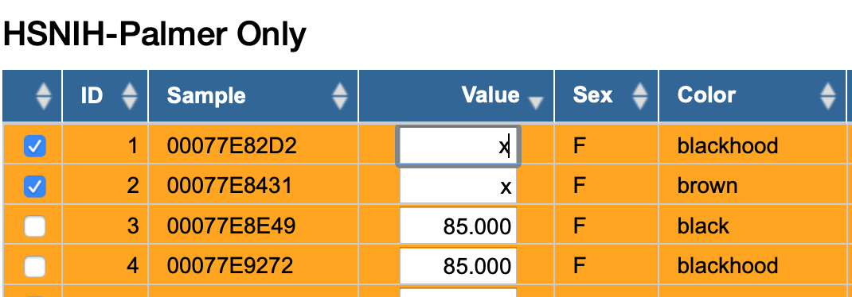
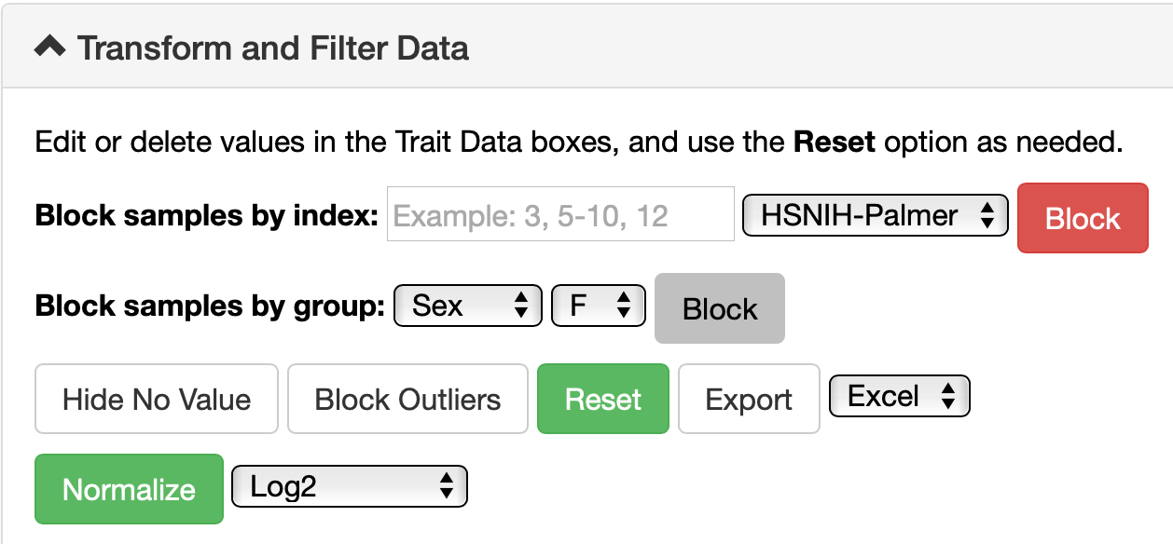
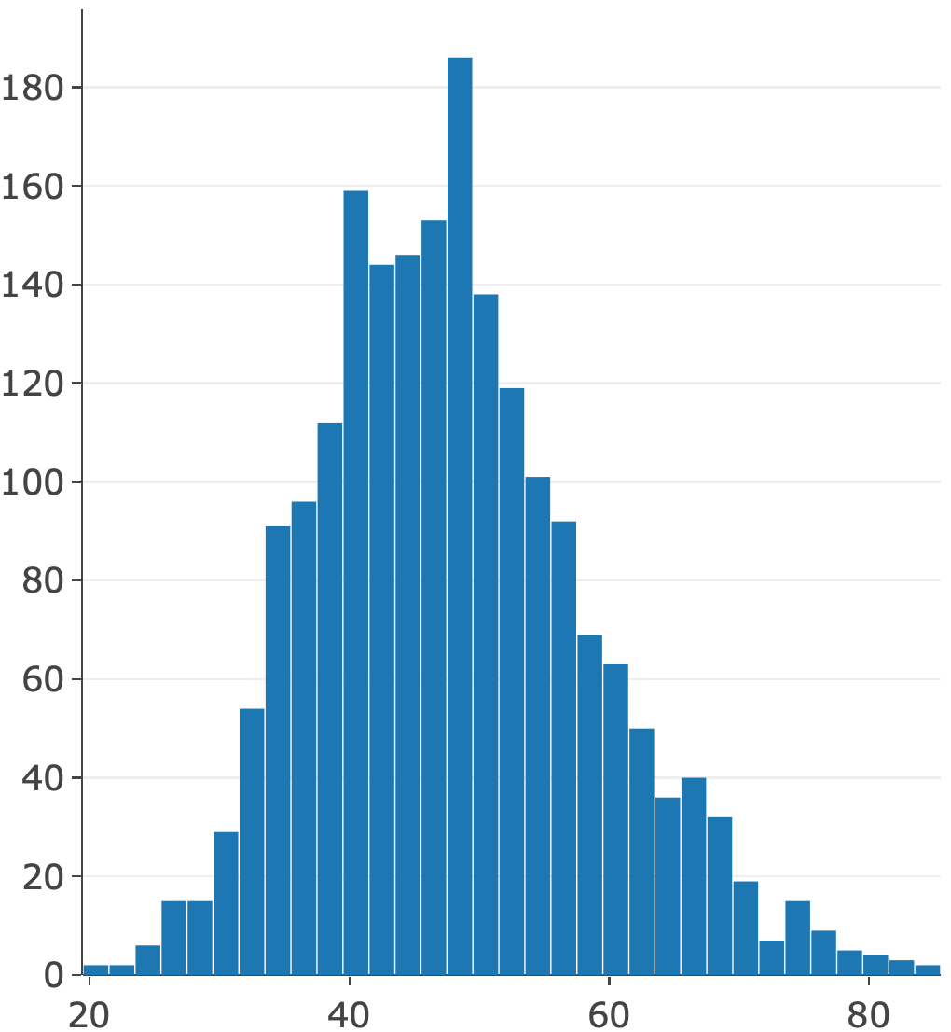
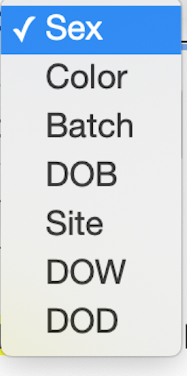
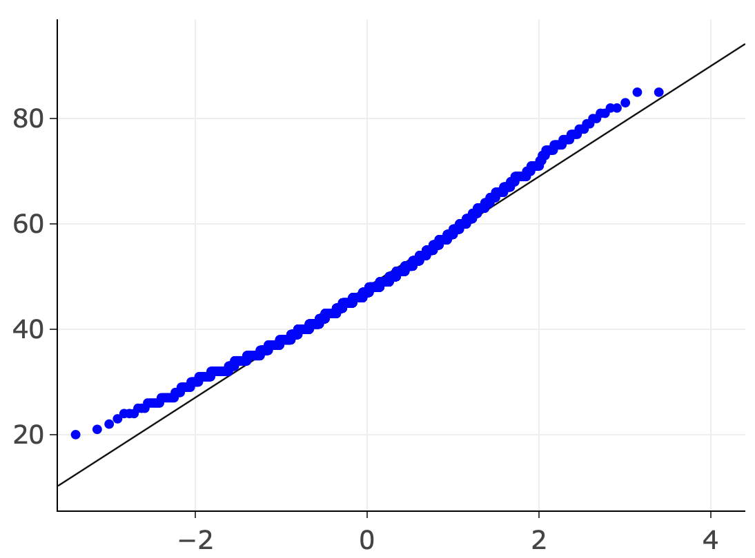

Normalizing and blocking data
Normalize by changing scales first. This affects all values. Blocking samples. Blocking is only additive.
Reset and Export
Slide 11. Normalizing and blocking. In this example the goal is to map male and female cases separately and then jointly. Left. The first step is to use the Transform and Filter Data tab functions, specifically Block samples by group: Sex = M. This action replaces male Values with an x. You can block by Site, Batch, Color. Right. Review Statistics again, especially Basic Statistics and Histogram. Censor the two highest body weights (92 and 94 g).

Slide 12
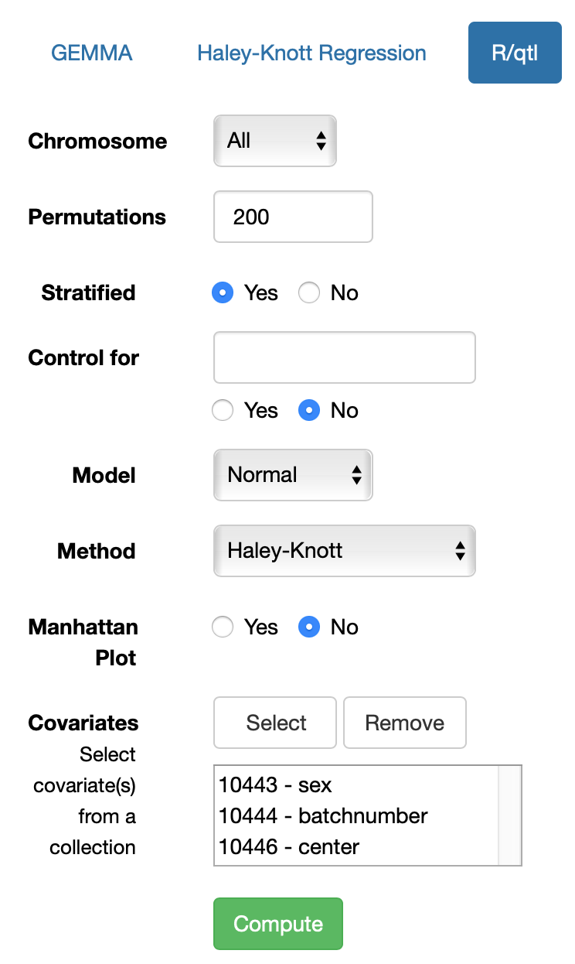

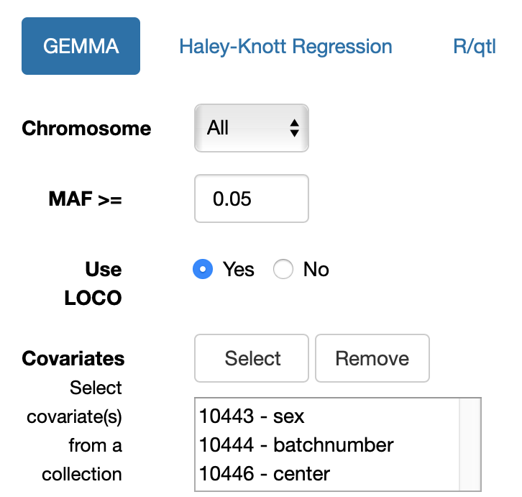
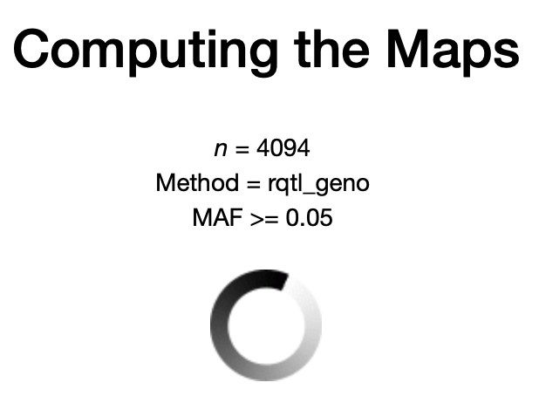
Selecting covariates for mapping (all cases)
Slide 12. Mapping all cases. Left. Before mapping variation in body weight, select appropriate cofactors to include in the analysis from your HS_RAT_GWAS collection (red arrow). Covariates sex, center, and batchnumber have been selected here for mapping. GEMMA or (Right) R/qtl can be used for mapping the HS. In R/qtl, 200 stratified permutations will run. Leave other default selections as is. Click Compute. Computing the Maps progress bar will appear. Wait forever—just joking; but a good time for a coffee break (~45 min).

Slide 13
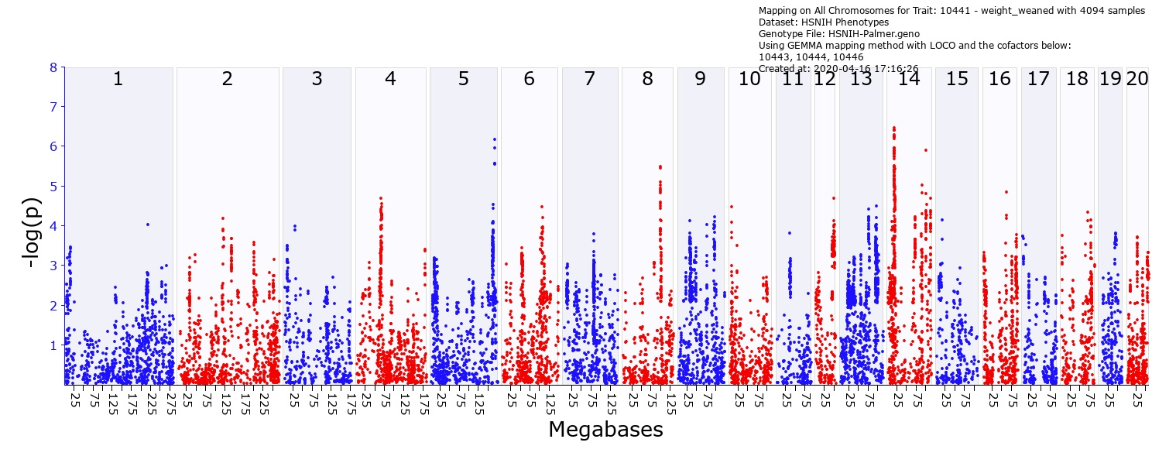
Maps for body weight with cofactors with GEMMA (about 45 minute job)
Slide 13. Top. Maps for both males and females with three cofactors: batch, sex, and center (HSR_10443, 10444, 10446). The x-axis lists chromosomes on a megabase (Mb) scale, except Chr X and Y. The y-axis is minus the logarithm of the linkage probability (–log p). The Chr 14 locus has a peak linkage of about 6.4. These maps can be zoomed to single chromosome level or even small parts of chromosomes.

Slide 14
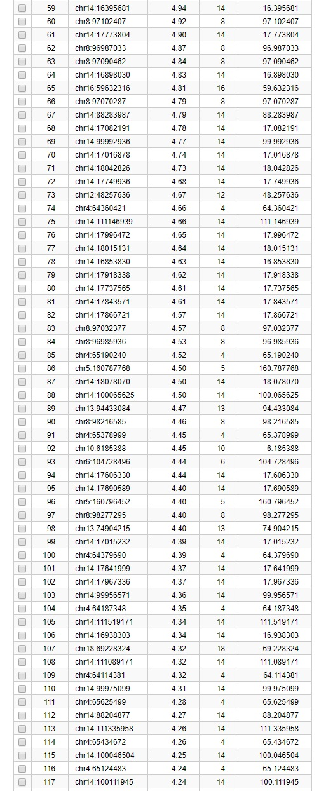
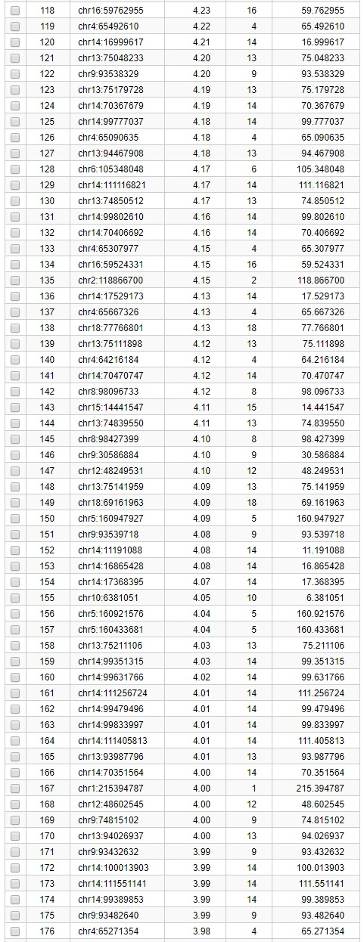
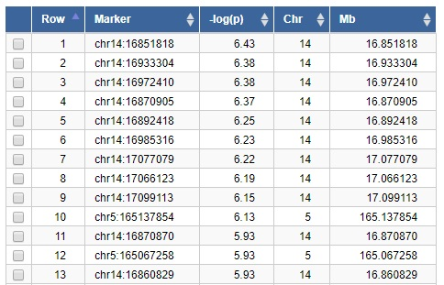
Linkage results table
Mb
Slide 14. Left. Table of the –log p linkage scores sorted from high to low by marker and position. The highest score for body weight is 6.4 on Chr 14 at 16.851818 at Mb. Middle and Right. A 1.5 confidence interval drop in both proximal (top arrows) and distal (bottom arrows) directions from the peak is used to define an approximate confidence interval (CI). Sets of red arrows mark approximate 1.5 CIs.

Slide 15
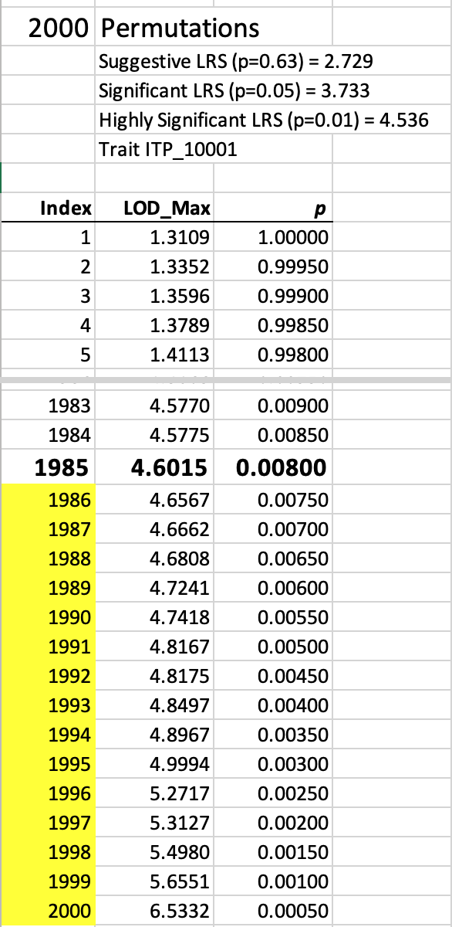
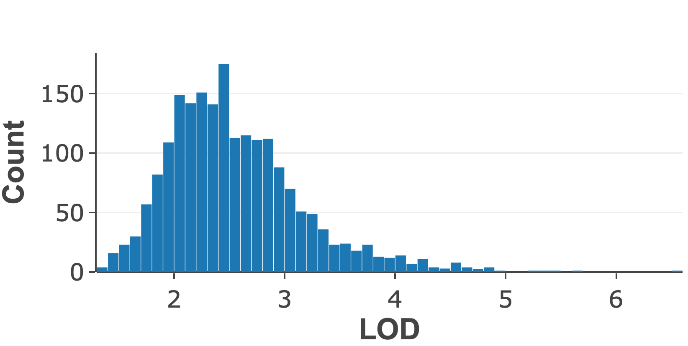
Stratified permutation testing
Mb
4.64
Slide 15. Left. Peak linkage computed for 2000 stratified permutations of phenotypes within cofactors when using R/qtl. In this example, only 15 of 2000 permutations have LOD peaks greater than 4.64. The genome-wide alpha of linkage to Chr 11 is therefore p <0.01. Right. The permutation results can be downloaded as comma-separated-value text files. Here data have been entered into Excel to highlight the few permutations that exceed the value of the locus of 4.64. Note that each permutation run will provide somewhat different thresholds. Before publication compute thresholds using at 1000 – 2000 permutations—currently an overnight calculation of HS rats.

Slide 16

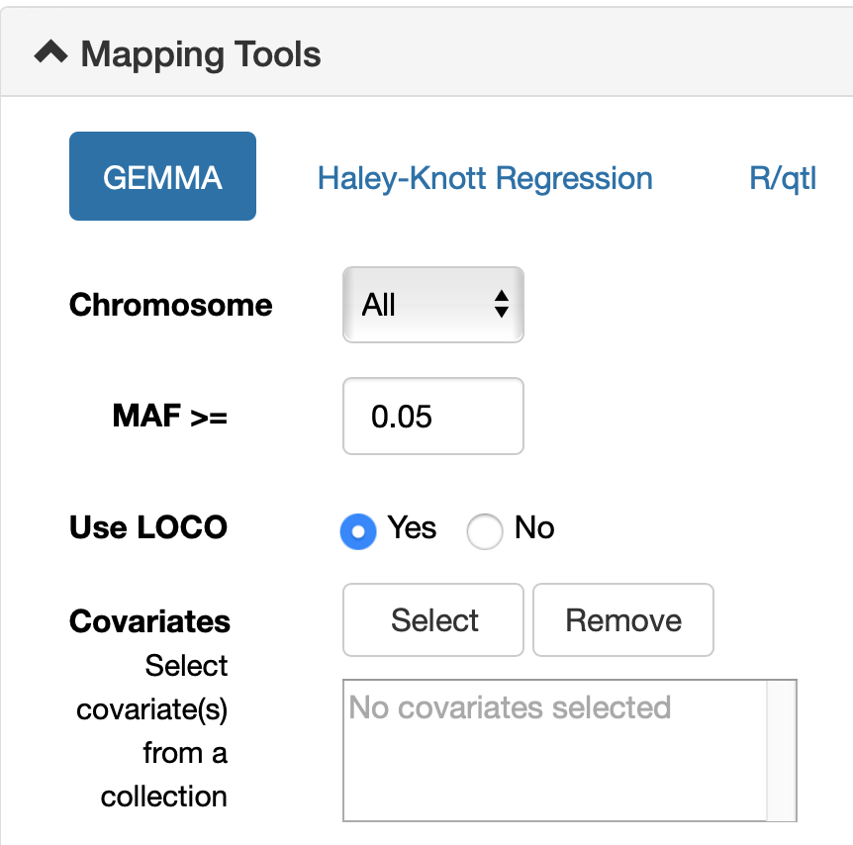
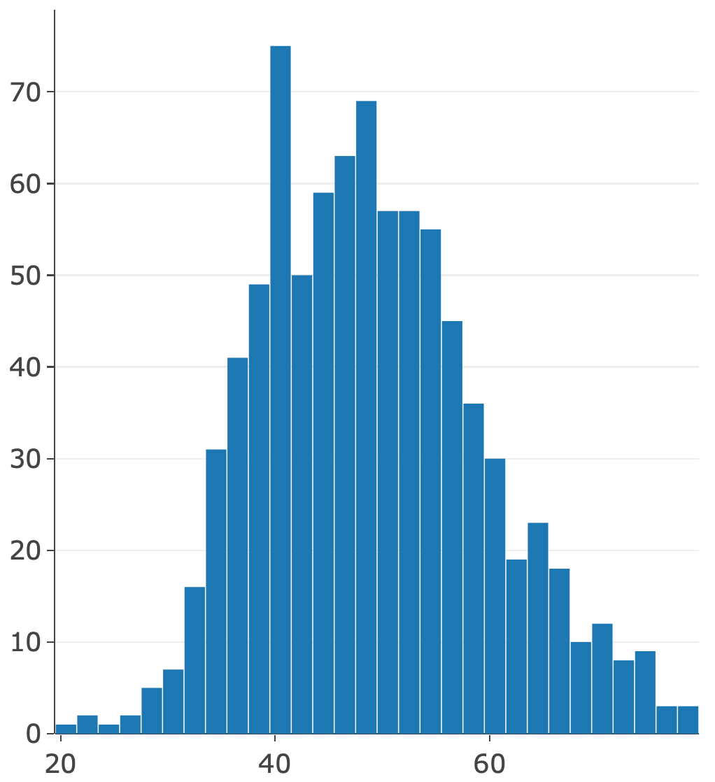
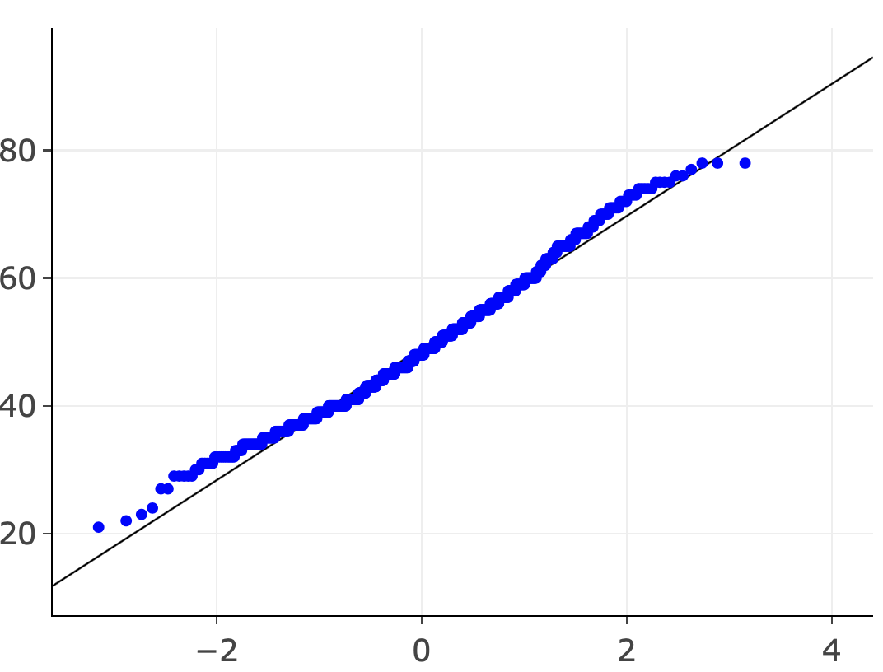


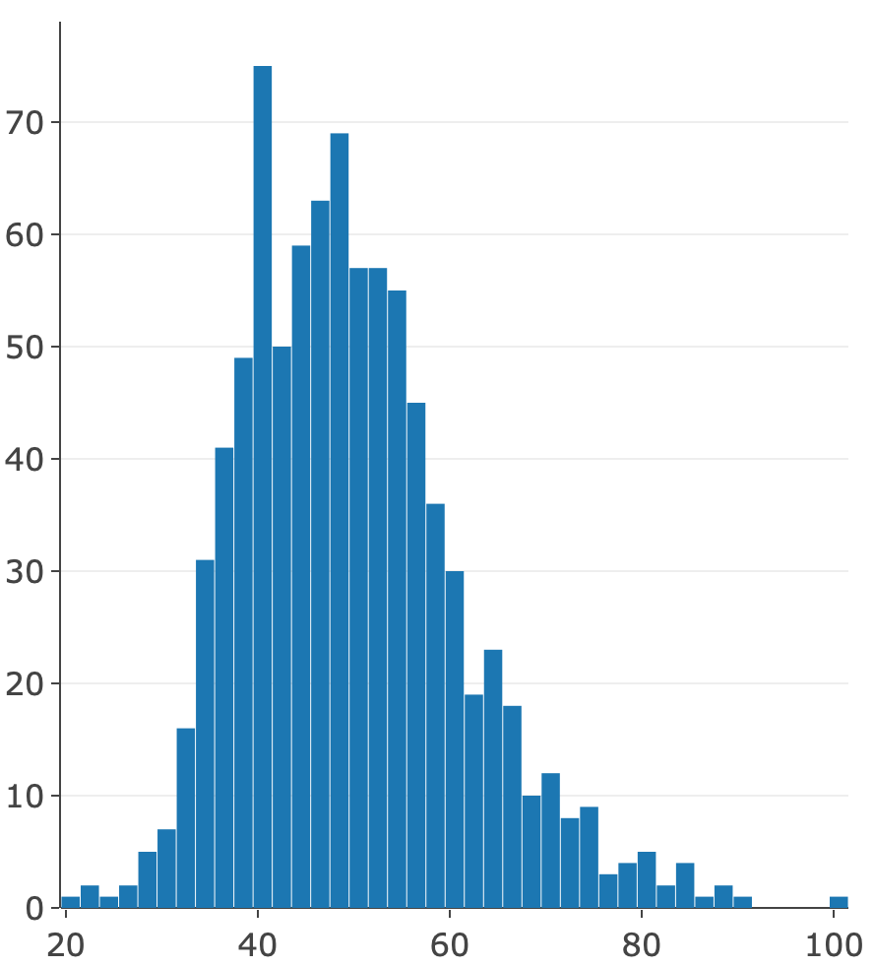
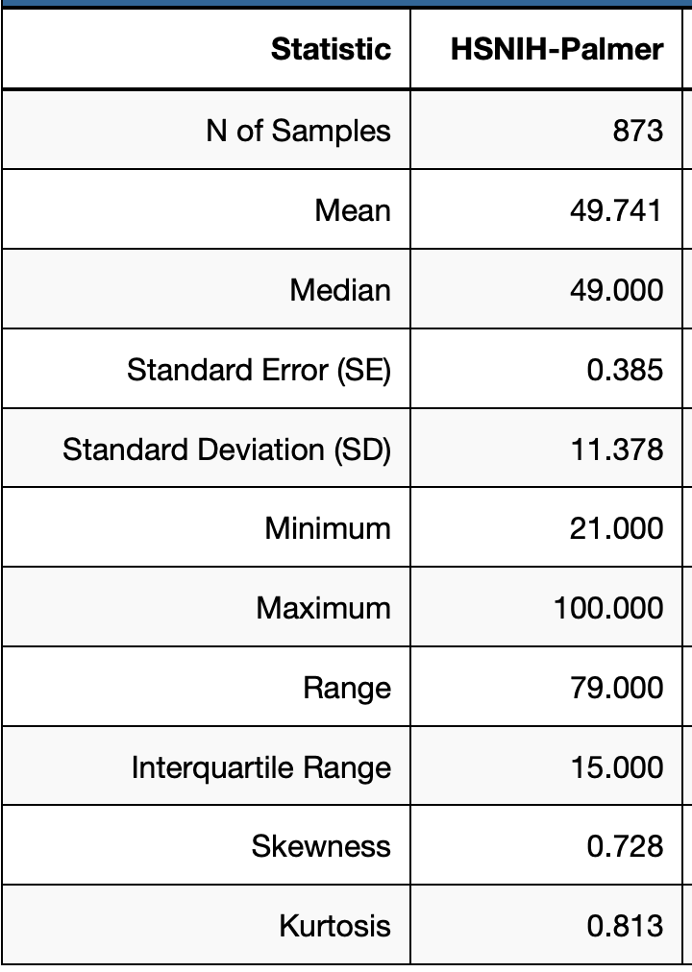
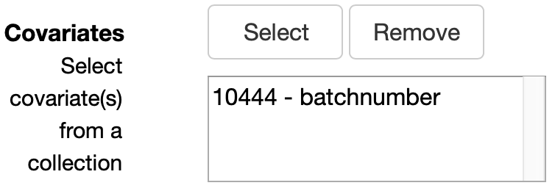
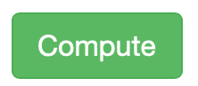
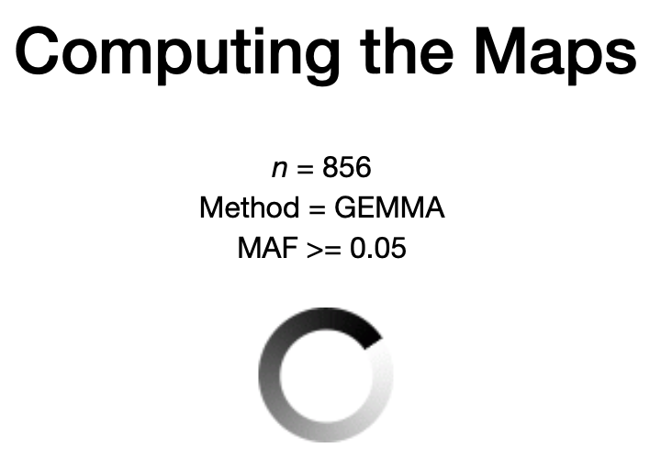
Test question: Map male weight from NY correcting for batch and excluding 17 outliers
1
5
2
6
3
4
7
Bonus test question. How sensitive are results to a log2 transformation?
8
Slide 16. Eight simple steps (clues) highlighted from the GeneNetwork interface

Slide 17
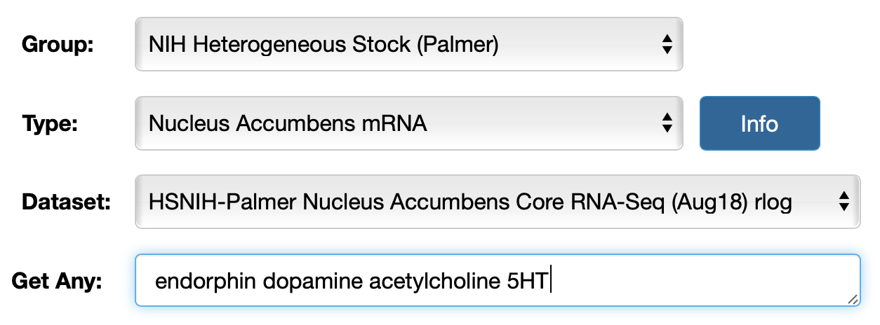
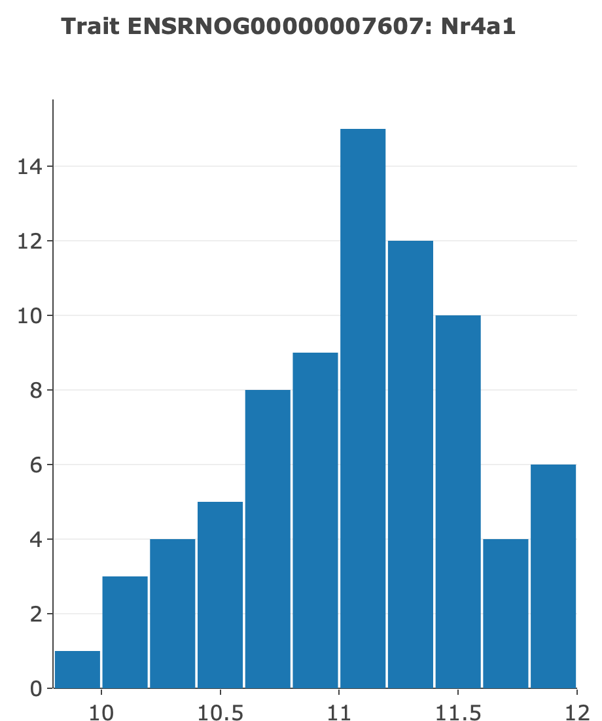
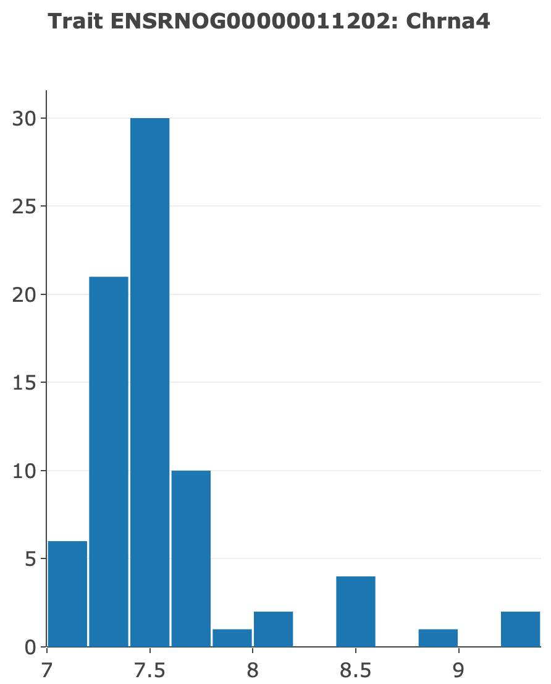








HS expression data in GeneNetwork: a ton of RNA-seq data
NAc
NAc
NAc
NAc
Nurr77
Chrna4
Scn4b
Ntsr1
Fosb
Arc
Nr4a2
Nr4a2
Nurr1
Nurr1
NAc
NAc
NAc
Prelimbic
? r
? r
Slide 17. Left. The same tools work with all HS omics data. Expression distribution require care, but are highly revealing. What are the correlations of Arc to Fosb in nucleus accumbens (Nac)? What is the correlation of Nr4a2 (aka Nurr1) in NAc and prelimbic cortex (red bimodal histogram)?

Slide 18




HS expression covariation: 4D scatterplots of Pearson r and Spearman rho
Fosb
Arc
Slide 18. Left. Arc and Fosb are both immediate-early genes and have Pearson’s correlation of 0.7. Males in blue, females red, and the batches as circle size 1, 2, 3, 4. Right. Spearman rank correlation of 0.44 between the key dopaminergic gene Nurr1 (aka Nr4a2) in prelimbic cortex (x-axis) and NAc (y-axis).

Slide 19



Nr4a2 expression in prelimbic cortex: what other genes covary?
Nr4a2
Prelimbic
Slide 19. Correlation of one transcript with all others. It is possible to set a minimum threshold of 5 log2 units.

Slide 20

Initial conclusions
P50 reports rock
Crf_MI
01Apr2020
Much of the mapping workflow is in place. We need smoother data and metadata entry methods.
The HS Rat GWAS data and genetic analysis is FAIR-compliant in GeneNetwork.
All code is accessible on GitHub https://github.com/genenetwork/genenetwork2.
You can replicate and tweak models when mapping any of the P50 traits. You can do this on your own without much hassle.
It is a short step from the P50 reports you get from Apurva to the P30 reports you can generate in GN. Our goal is to make sure these reports converge perfectly (replicable work flows).
As the rat genome assembly and sequence data for the eight parents of the HS improve, all traits will be remappable on the new assemblies and with ”overlay” tracks of sequence variants and haplotypes in every locus.
Slide 20. Conclusions

Slide 21
Pending work
Implement stratified permutation by sex, site, year (Sloan, done April 9). Compute FDR for full set of “significant” QTLs.
Enter and QC genotype, phenotypes, cofactors for all HS cases (Chitre, Centeno, Williams, done April 2020)
Enter genotypes into MariaDB for use as cofactors (Centeno, Chitre, Palmer, in progress)
Estimate effect sizes and polarities of all alleles/haplotypes (Williams, Sen, Prins, in progress)
Implement password access control for data until publication (Prins, Sloan, Fischer, May target)
Test for interaction effects of sex and other cofactors with loci (Williams, Arends, in progress)
Evaluate multiple-locus interactions using loci with main effects (Sen, Williams, Palmer…)
Develop more formal methods to combine HS and HRDP phenotype data (longterm goal)
Evaluate positional candidate genes (Palmer and teams)
Refine API for data export from GeneNetwork (Prins, Sloan, Sen, Centeno)
Plan comparative human GWAS/PheWAS components (Prins, Sen, Williams)
Draft a technical paper for a replicable behavioral genetics (whole team)
Slide 21. Work in progress

Slide 22



Your suggestions
Faster mapping and permuting
Better metadata and descriptions
Faster page loading
Default parameter mapping results databasing
How about Chr X? It is a genetic hotbed.
Your ideas
Error messages in GN are cool ;-)
KOs
Us
GN Heroes
Slide 22. What to do next

